Slide 1

Wel Come

Slide 2
Presented by:
Md:Golam Hossain(Sumon)
Assistant Teacher
Khatra Bilway Govt PrimarySchool
Hajigonj ,Candpur

Slide 3
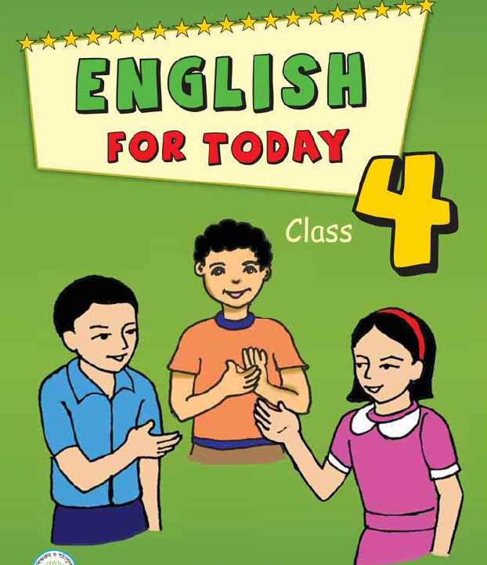
Mita’s Day
Unite -14
Lesson 1-2
Mita is….o’clock.

Slide 4
Learning Outcomes
4.4.3-Enjoy to understand simple stories.
6.2.1-Talk about people,object’s,event etc.
5.1.2-Reading silently with understanding stories and other’s text.
102.write a short composition about youself.

Slide 5
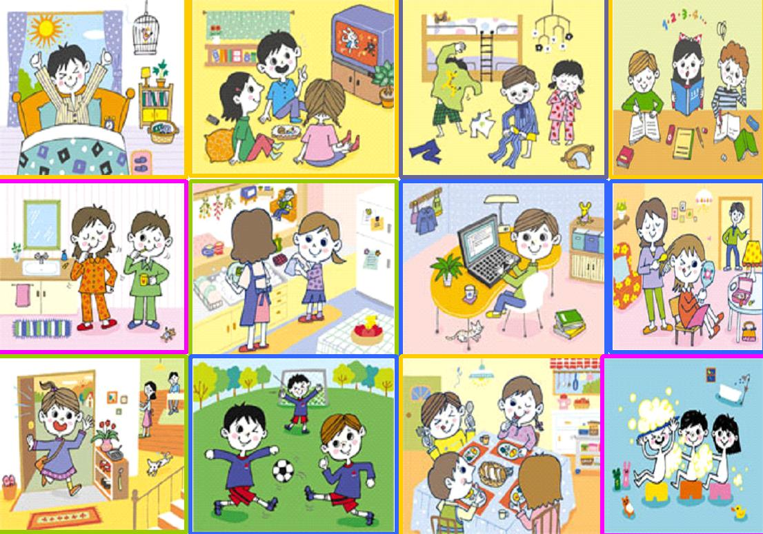
Safe envirment of the class
What can you see in the pictures?

Slide 6
Lesson Headline
Mita’s day

Slide 7
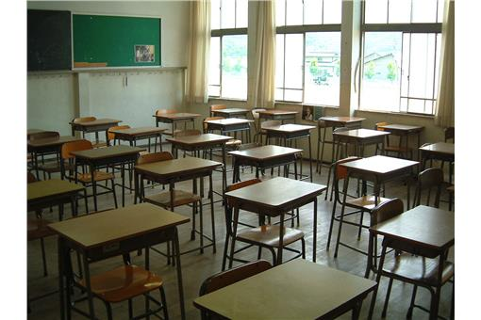
presentration
Class four
Mita is in class four.

Slide 8
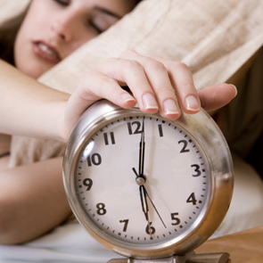
She gets up at six o’clock

Slide 9
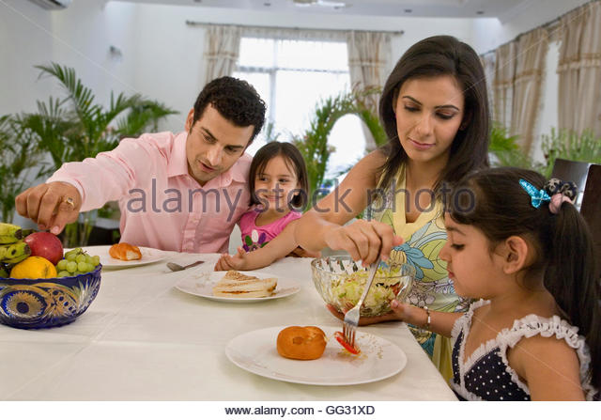
She has breakfast at seven o’clock

Slide 10
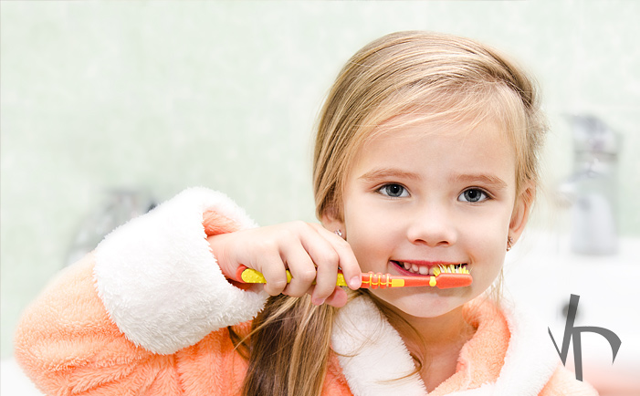
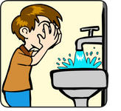
She brushes her teeth and wash face

Slide 11
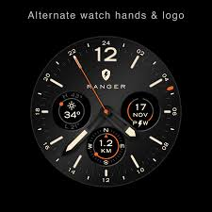

She goes to school at nine o’clock

Slide 12
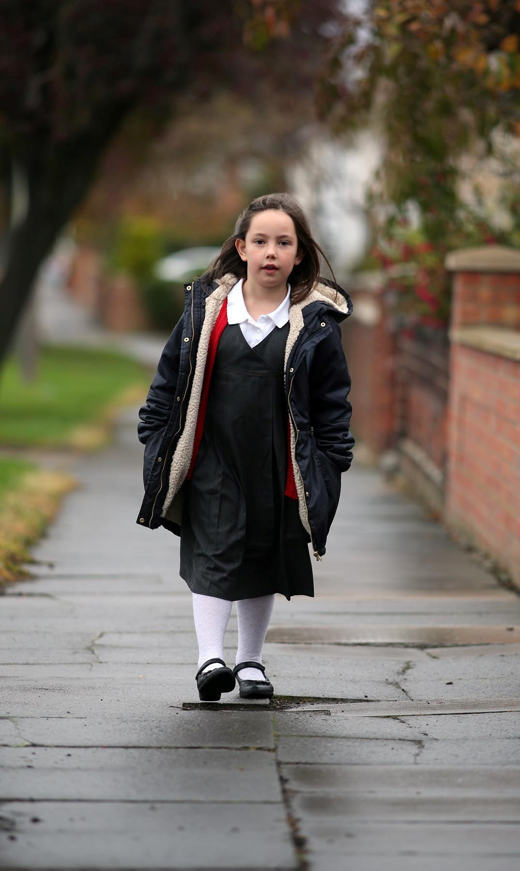
She walks to her school

Slide 13

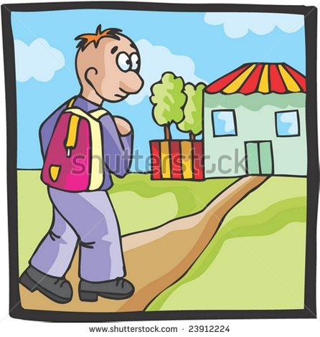
After school she visits to grandfather.

Slide 14
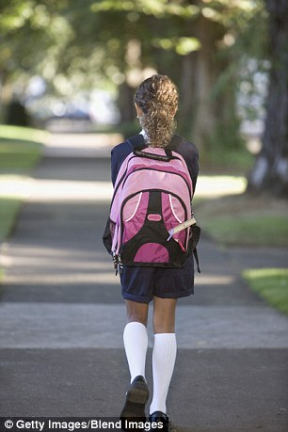
Mita return to home at five o’clock.

Slide 15
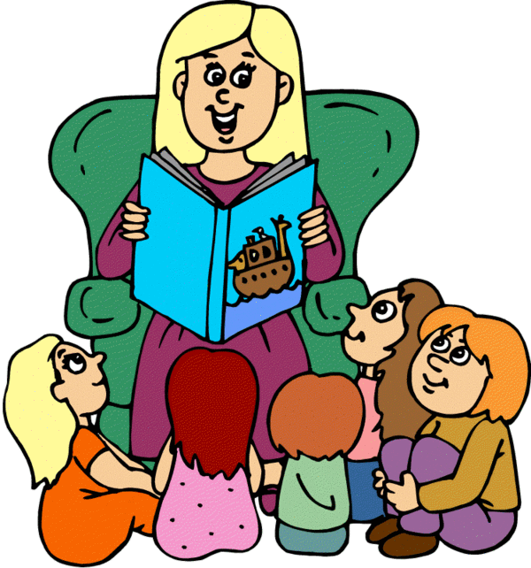
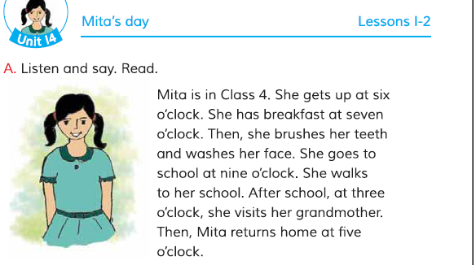
Teacher’s loud reading

Slide 16
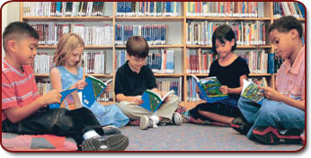
Students silent reading

Slide 17
Assessment
Fill in the gaps
1.Mita gets up at… ….
2.She has ………. at seven o’clock.
3.She goes to……... at nine o’clock.
4.She ……. her grandmother house.
5.She returns home at.........
six
Breakfast
school
visits
five

Slide 18
Answer to questions:
1.Mita is in class 4.
2.After breakfast Mita brush her teeth.
3.Mita goes to school on foot.
1.What class Mita reads in?
2.What does Mita do after breakfast?
3.How is Mita goes to school?

Slide 19
Home Work
Write 5 sentence about your “Everyday life”

Slide 20
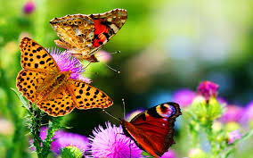

The Time is finished
Thanks all

